Slide 1
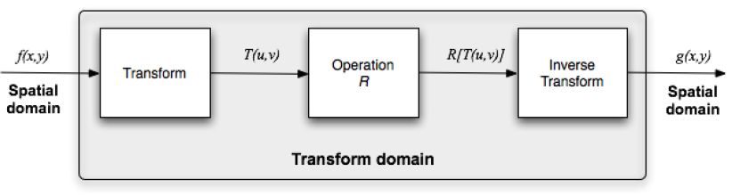
Overview of image processing operations
Spatial domain
Transform domain (Frequency Domain)
CUI, Lahore Campus -- CSC 331: Digital Image Processing -- © Dr. Usama Ijaz Bajwa

Slide 2
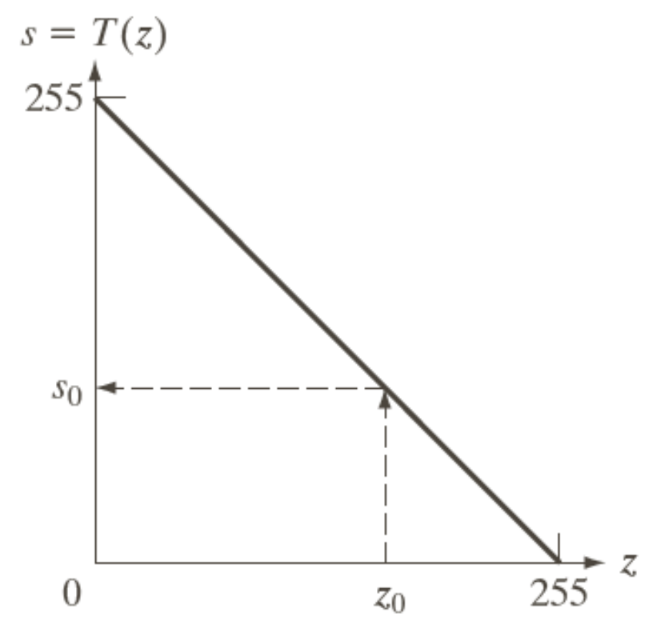
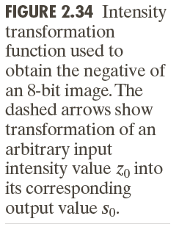
Spatial Operations
Single Pixel Operations (Point Operations), s = T(z)
Neighborhood Operations
Geometric Spatial Transformations and Image Registration
CUI, Lahore Campus -- CSC 331: Digital Image Processing -- © Dr. Usama Ijaz Bajwa

Slide 3
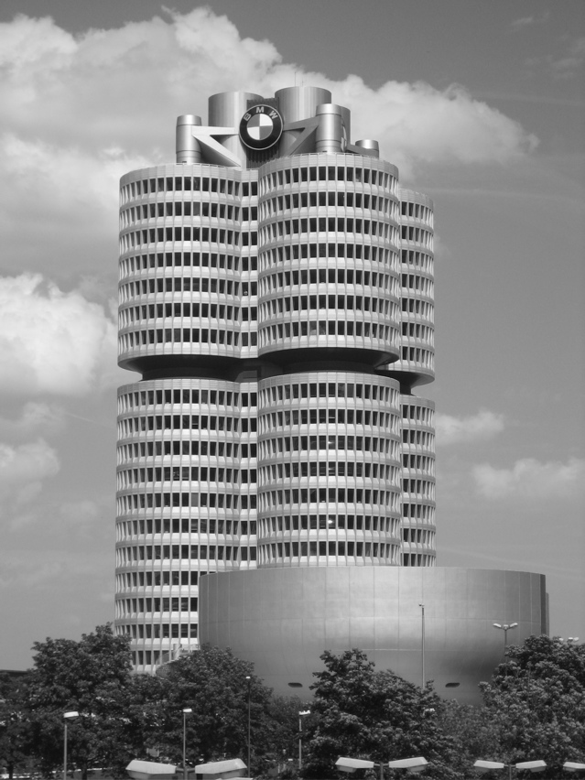
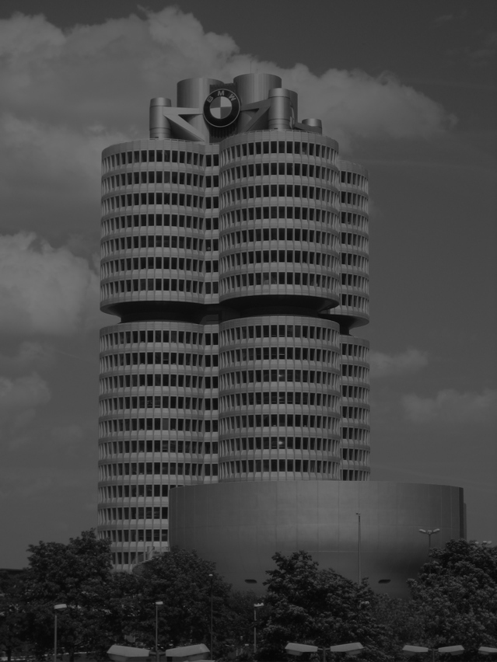
Point Operations
Example:
s = r/2
CUI, Lahore Campus -- CSC 331: Digital Image Processing -- © Dr. Usama Ijaz Bajwa

Slide 4
Spatial Operations - Neighborhood Operations
Neighborhood-oriented operations consist of determining the resulting pixel value at coordinates (x,y) as a function of its original value and the value of (some of) its neighbors, using a convolution operation.
The convolution of a source image with a small 2D array (mask or kernel) produces a destination image.
The convolution mask determines which neighbors are used as well as the relative weight of their original values.
CUI, Lahore Campus -- CSC 331: Digital Image Processing -- © Dr. Usama Ijaz Bajwa

Slide 5
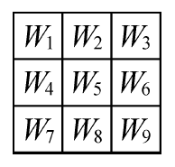
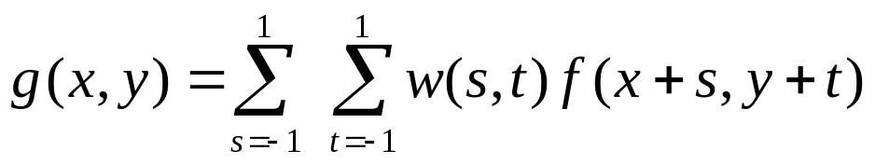
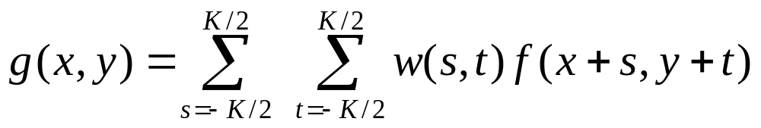
Spatial Operations - Neighborhood Operations
Masks are normally 3×3.
Each mask coefficient can be interpreted as a weight.
CUI, Lahore Campus -- CSC 331: Digital Image Processing -- © Dr. Usama Ijaz Bajwa

Slide 6
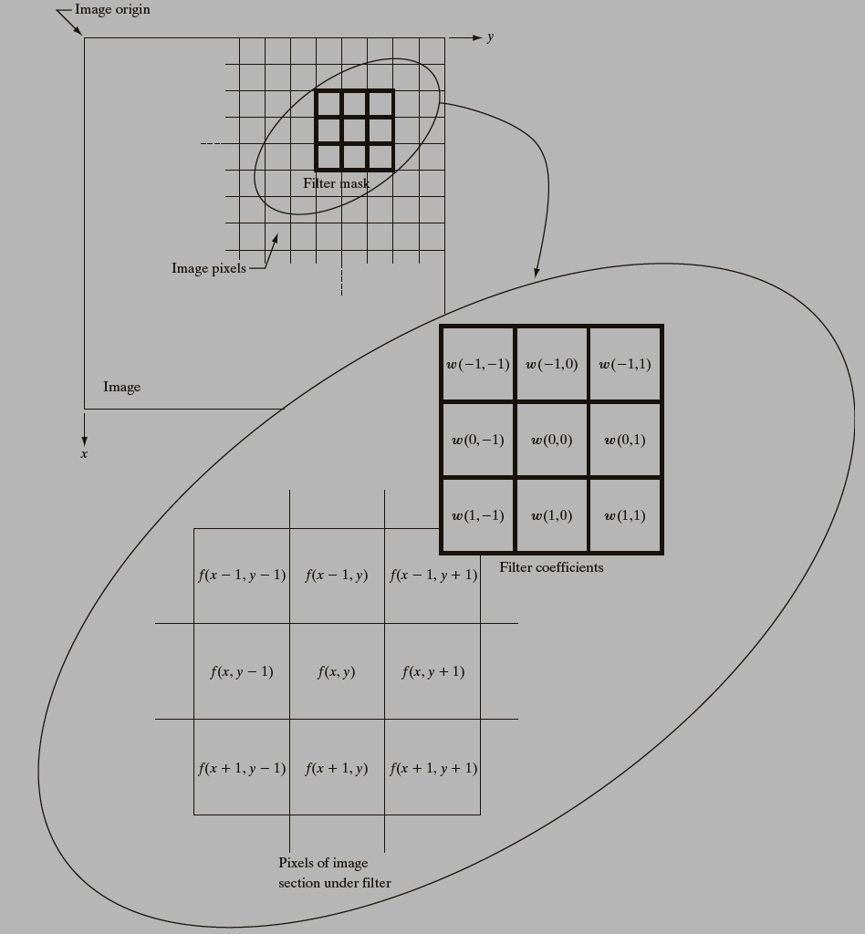
Spatial Operations - Neighborhood Operations
CUI, Lahore Campus -- CSC 331: Digital Image Processing -- © Dr. Usama Ijaz Bajwa

Slide 7
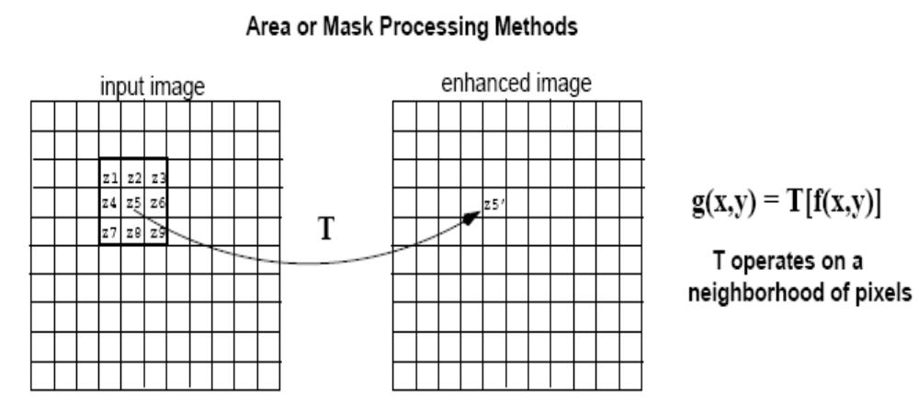
Spatial Operations - Neighborhood Operations
A filtered image is generated as the center of the mask moves to every pixel in the input image.
output image
CUI, Lahore Campus -- CSC 331: Digital Image Processing -- © Dr. Usama Ijaz Bajwa

Slide 8
Spatial Operations - Neighborhood Operations
Problems ?
Assignment (Applying a mask)
CUI, Lahore Campus -- CSC 331: Digital Image Processing -- © Dr. Usama Ijaz Bajwa

Slide 9
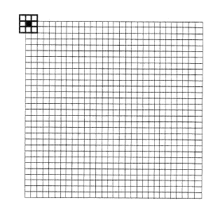
Spatial Operations - Neighborhood Operations
Solutions ?
pad with zeroes
0 0 0 ……………………….0
0 0 0 ……………………….0
CUI, Lahore Campus -- CSC 331: Digital Image Processing -- © Dr. Usama Ijaz Bajwa

